Slide 2
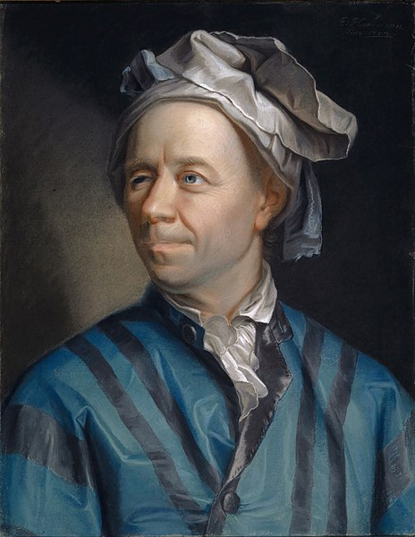
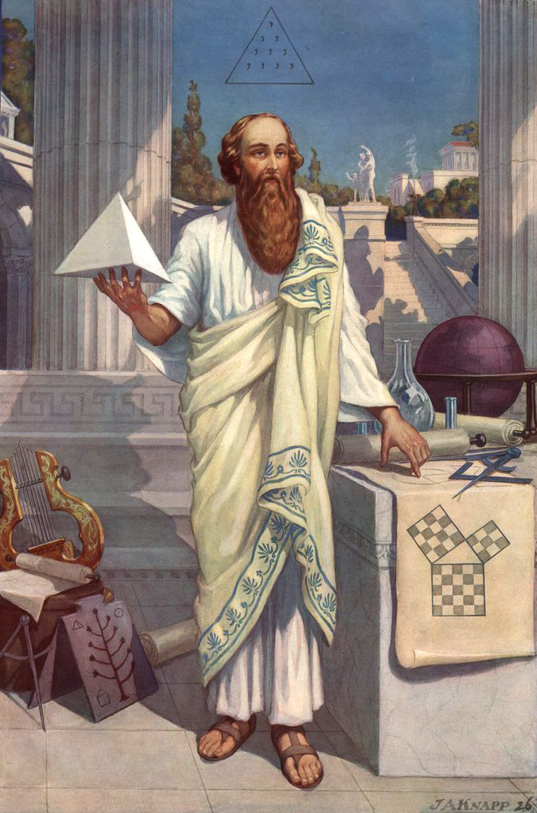
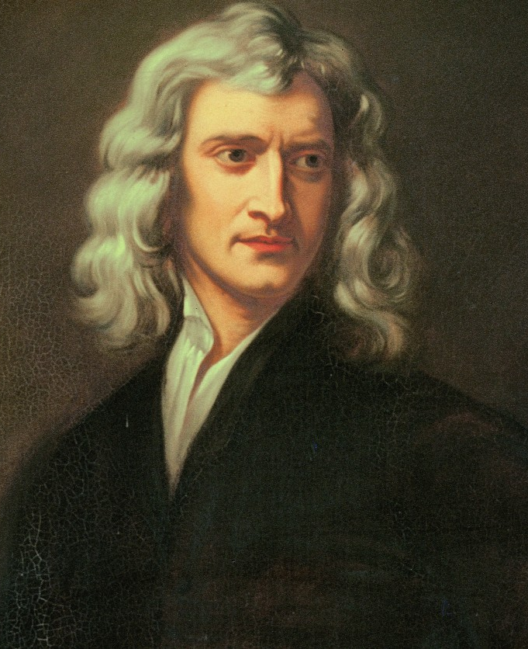
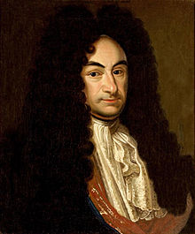
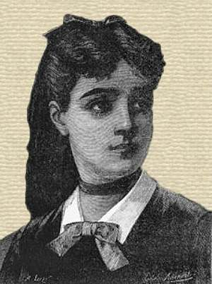

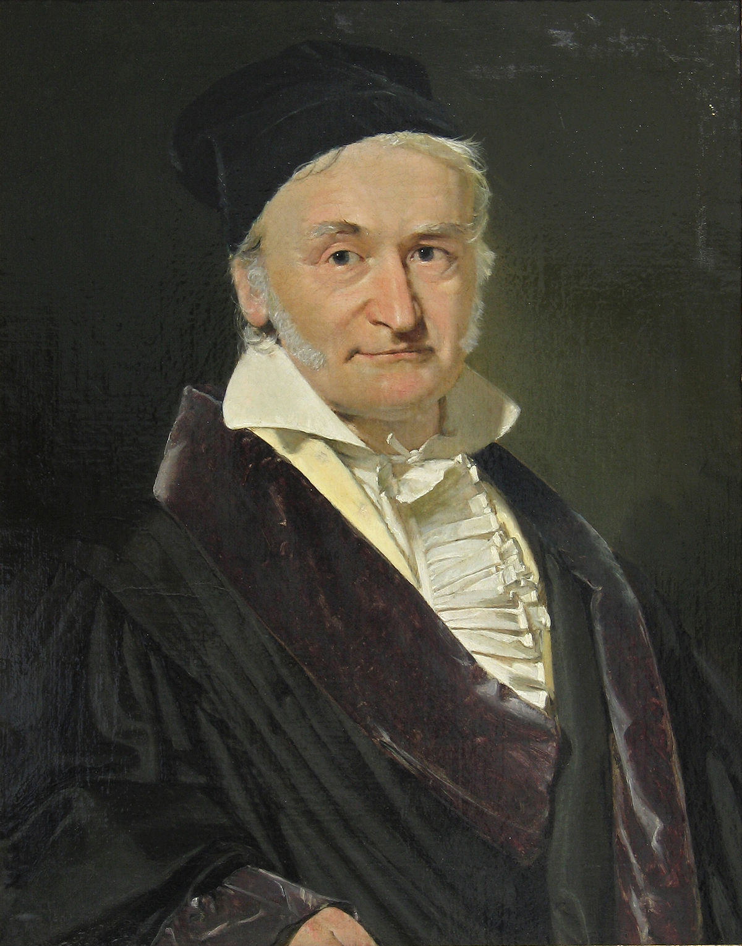
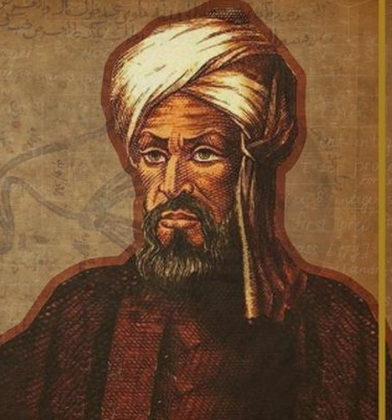
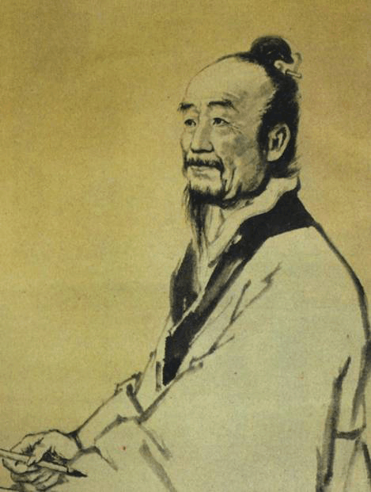
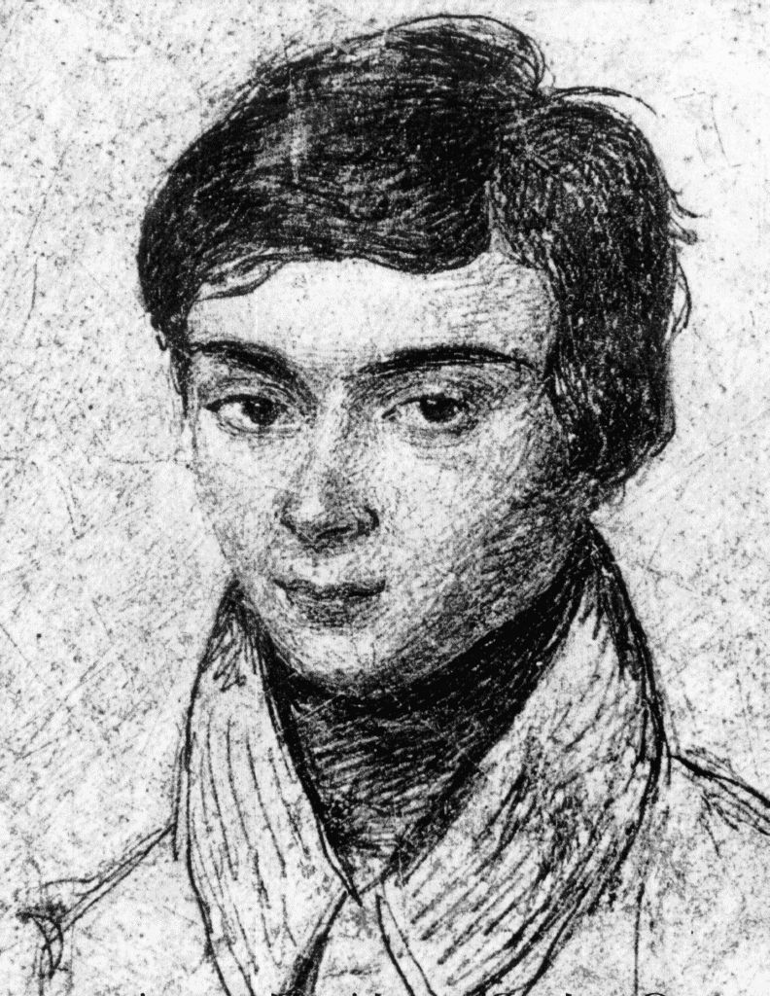
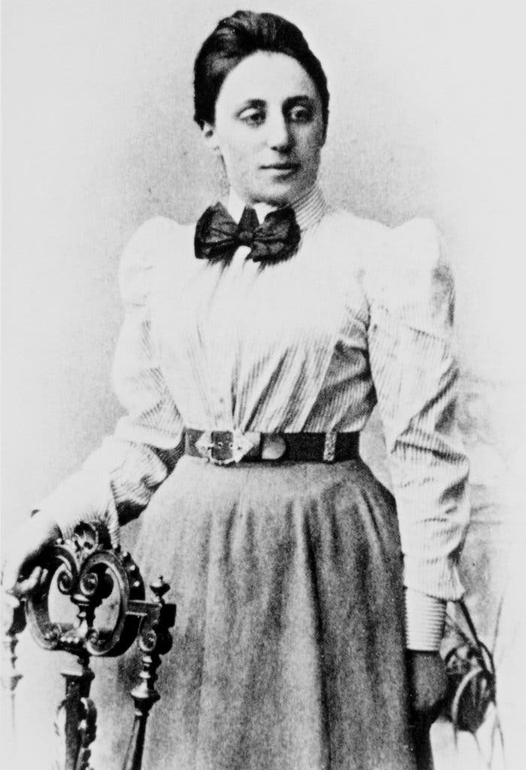
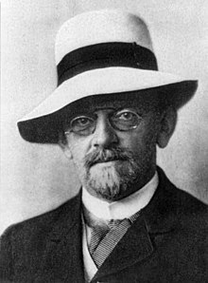
Maths Talk
Tristan Chaang

Slide 3
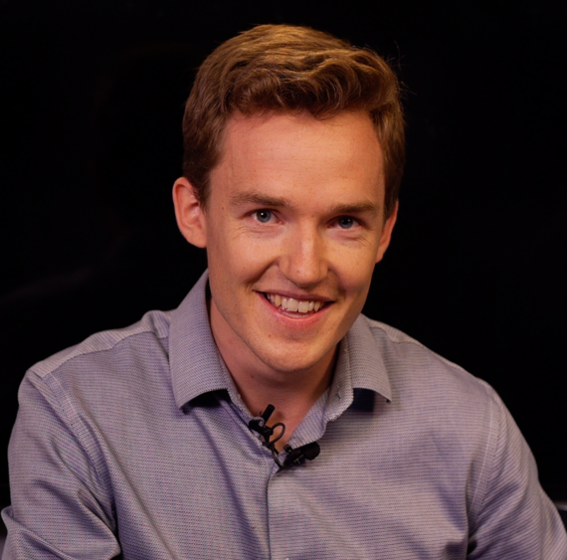
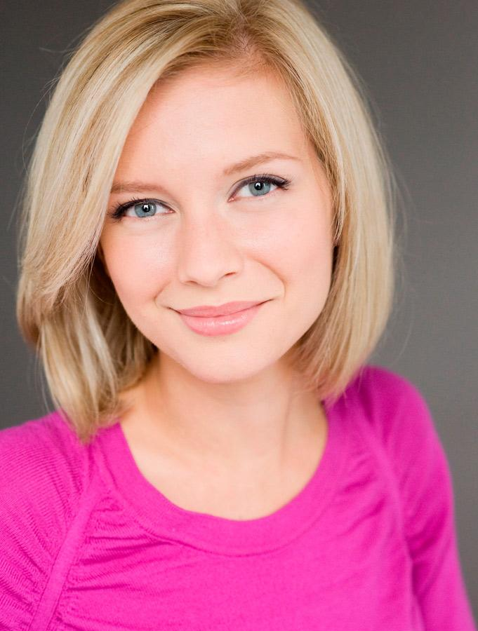
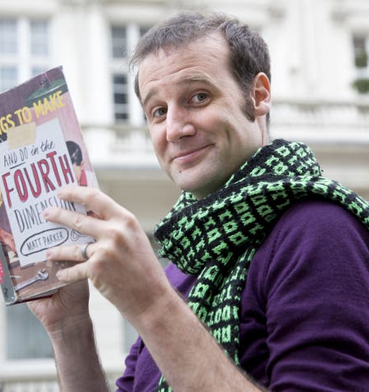
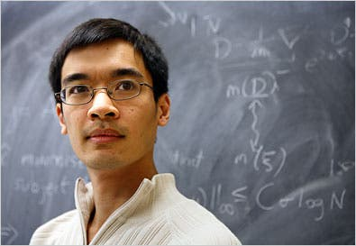
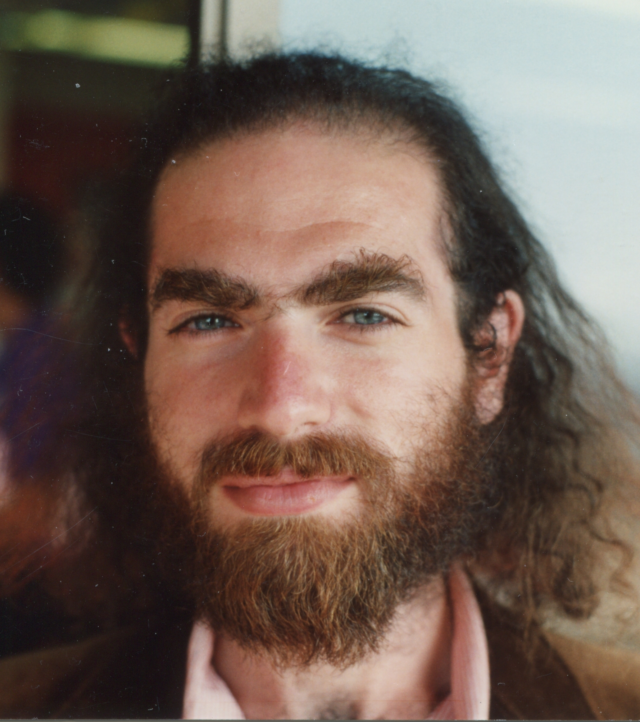
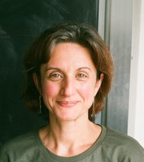
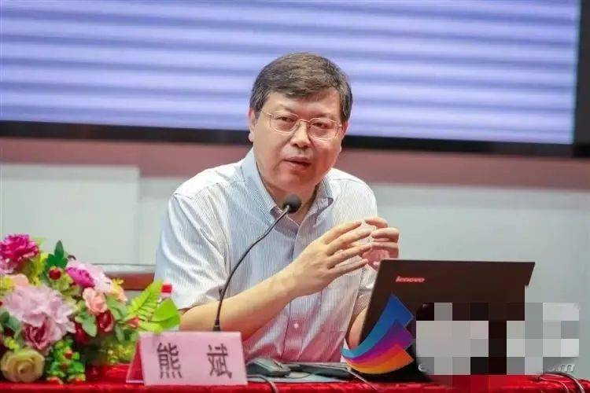
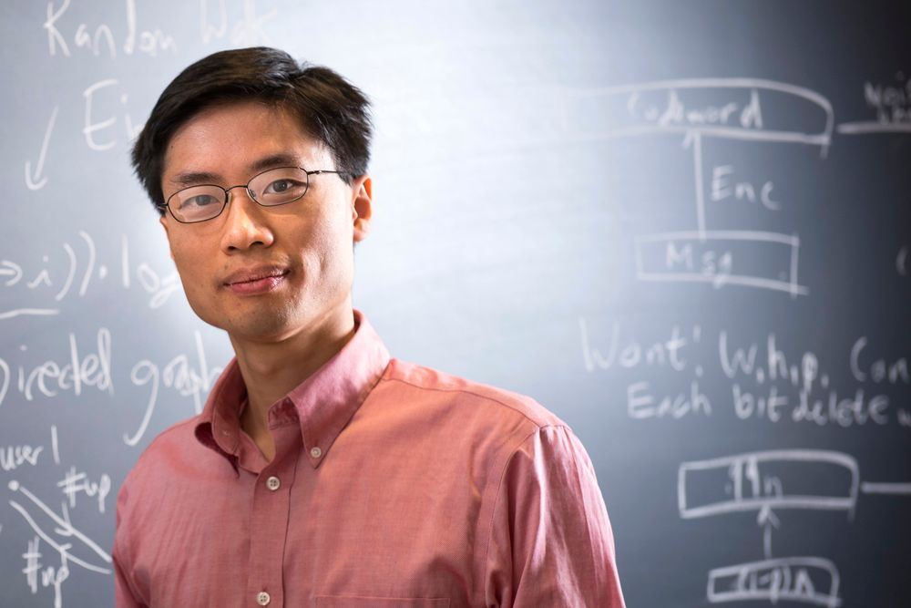
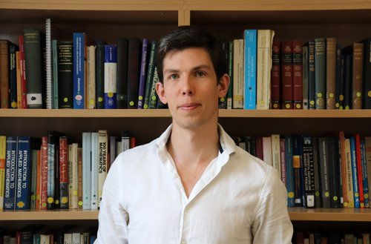
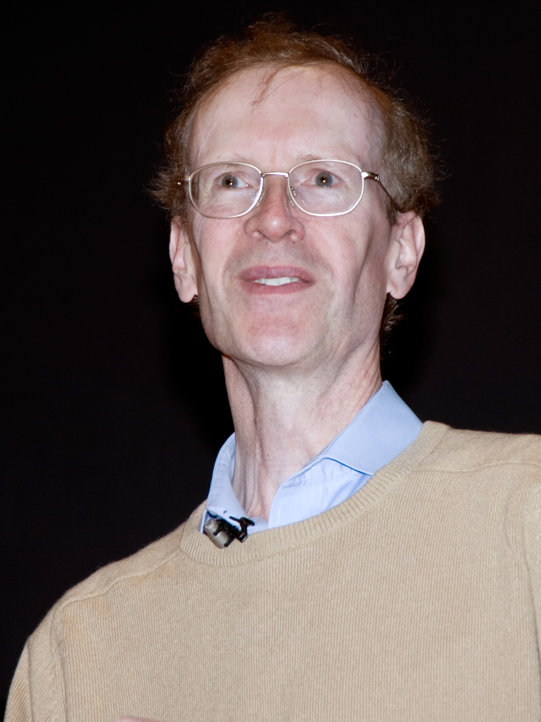
Maths Talk
Tristan Chaang

Slide 5
Write down a whole number from 1 to 10 at random

Slide 6
Flip a fair coin in your head 10 times
E.g. HTTHTHTTHH

Slide 7

Probability means Likelihood
$$\text{Probability}\text{ = }\frac{\text{Number} \text{of} \text{successes}}{\text{Number} \text{of} \text{outcomes}}$$
… or is it?

Slide 9
Probability means Likelihood
$$\text{Probability}\text{ = }\frac{\text{Number} \text{of} \text{successes}}{\text{Number} \text{of} \text{outcomes}}$$
… when the outcomes are equally likely!

Slide 10
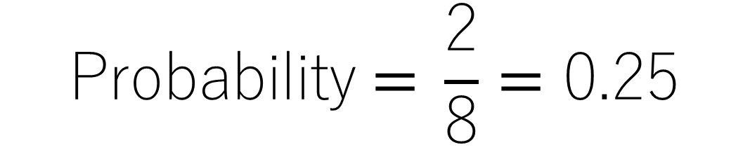
$$\text{Probability}\text{ = }\frac{\text{2}}{\text{8}}=\text{0.25}$$

Slide 12
Write down a whole number from 1 to 10 at random

Slide 13
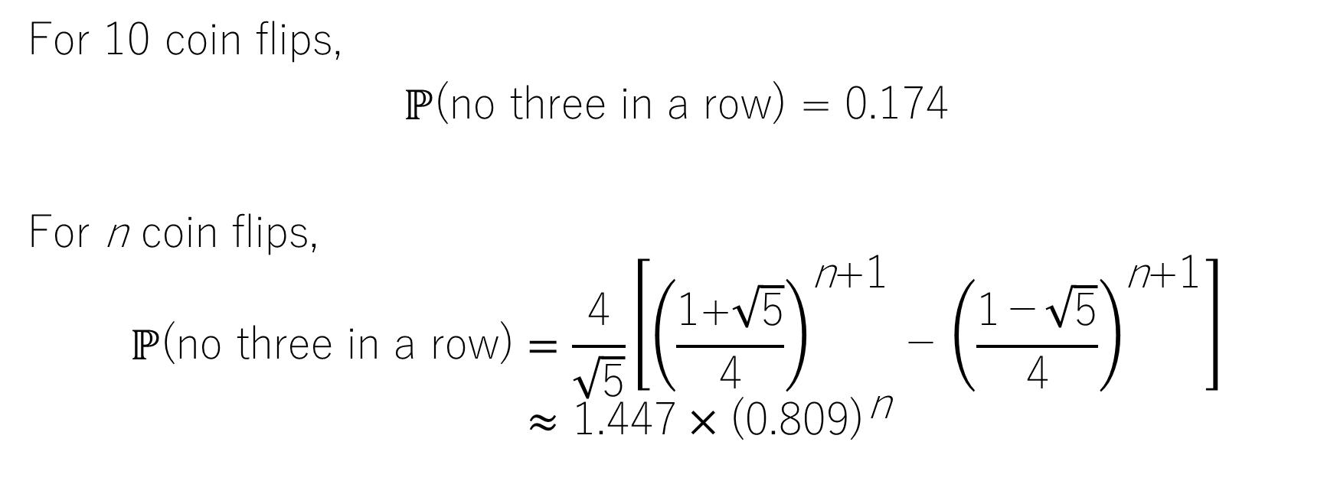
Flip a fair coin in your head 10 times
For 10 coin flips,
ℙ(no three in a row) = 0.174
For n coin flips,
$$ℙ\text{(}\text{no} \text{three} \text{in} \text{a} \text{row}\text{)}=\frac{\text{4}}{\sqrt{\text{5}}}\left[{\left(\frac{\text{1+}\sqrt{\text{5}}}{\text{4}}\right)}^{\text{n}\text{+1}}\text{−}{\left(\frac{\text{1}\text{−}\sqrt{\text{5}}}{\text{4}}\right)}^{\text{n}\text{+1}}\right] \\ ≈\text{1.447}{×\text{(0.809)}}^{\text{n}}$$

Slide 14
Humans are bad at randomness

Slide 15
B
A
B
A
A
B
a
b
a
b
a
b
Meiosis I
A
a
A
a
A
a
OR
A
a
B
b
b
B
B
b
b
B
50-50 chance
Independent Assortment!

Slide 16
Aa Bb
A
a
B
b
AB & ab
Ab & aB
50%
50%

Slide 17
What if A and B lie on the same chromosome?

Slide 18
A B
Aa Bb
A B
a b
a b
A
a
B
b
Meiosis I
AB & ab
Ab & aB
A B
a b
A B
a b
100%
0%
100% chance!
Or is it?

Slide 19
Crossing-Over!
A B
A B
a b
a b
A B
A b
a B
a b

Slide 20
Assume the further apart the alleles are,
The more likely they both cross-over

Slide 21
Genetic Sequencing
A-B distance
= (45+40+99+94)/1448
= 18.5
A-C distance
= (45+40+3+5)/1448
= 13.2
B-C distance
= (99+94+3+5)/1448
= 6.4
A B C
580
592
a b c
a B C
45
40
A b c
A b C
99
94
a B c
A b c
3
5
A C B
a B C

Slide 22
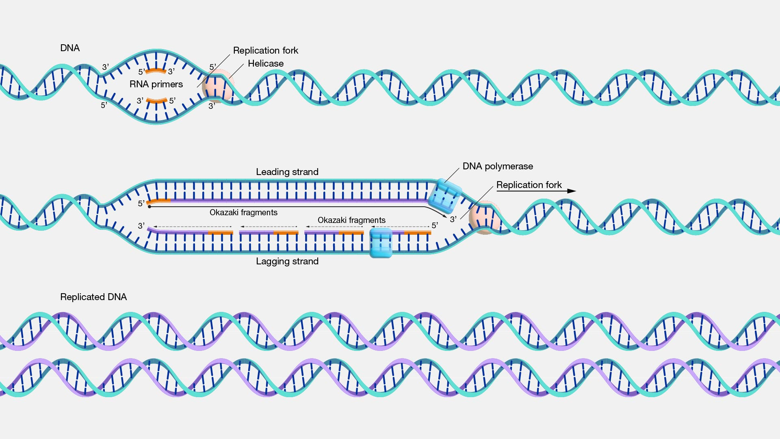
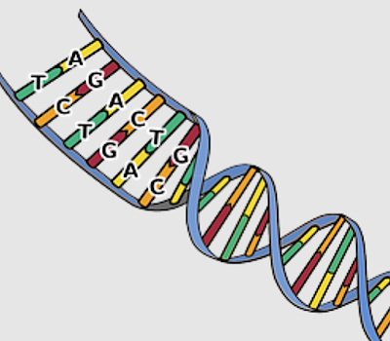
During DNA replication, there is 1 in 1000 chance of copying the wrong base pair
But there are 3.2 billion base pairs in a single cell!

Slide 23
Proofreading mechanism by DNA polymerase: reduces error to 1 in 100000
Base Excision Repair (Glycosylase) Nucleotide Excision Repair (Excinuclease)
When the final DNA strand is formed, the probability of mutation is
1 in 10 billion!

Slide 24


Slide 26
5
1
4
103
82
21

Slide 27
False Positives

Slide 28
Monty Hall Problem

Slide 29

1 Gift 2 Empty

Slide 30

Choose a door at random

Slide 31

Host opens another door that is empty

Slide 32

Should you switch to the untouched door?

Slide 33
Stay
Switch
Doesn’t matter, it’s 50-50
67% chance of winning!

Slide 34

100%
100%
0%

Slide 35
Should you switch to the untouched door?
Should you open the other two doors?

Slide 36
Birthday Paradox
How many people must be selected from a population so that it is > 50% likely to have two people sharing the same birthday?

Slide 37
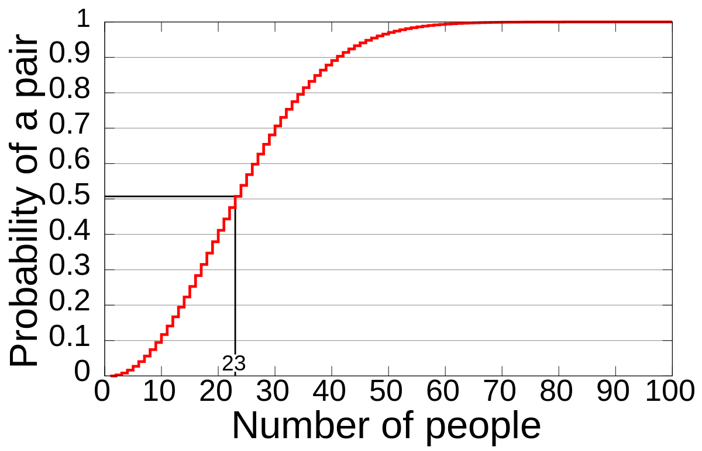
The answer is twenty-three!
# | Probability
23 | 50.7%
30 | 70.6%
40 | 89.1%
50 | 97.0%
55 | 98.6%
60 | 99.5%
70 | 99.9%

Slide 38

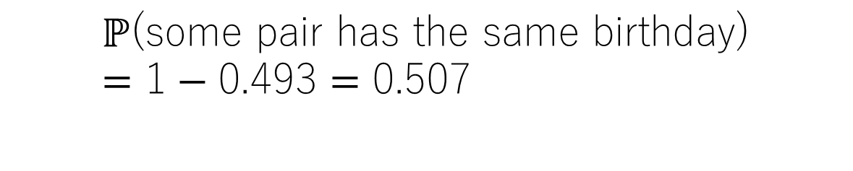
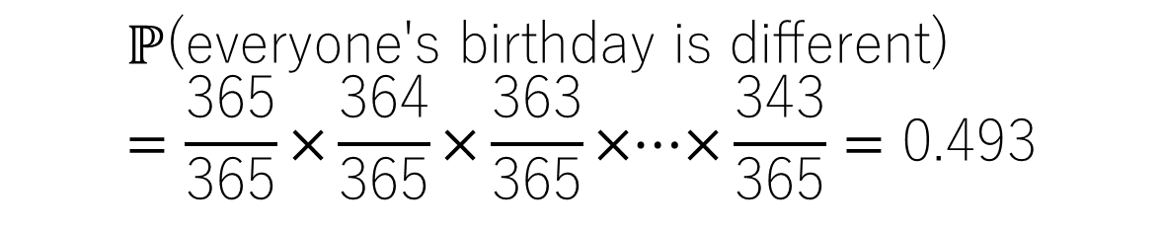
$$ℙ\text{(}\text{everyone}\text{'}\text{s} \text{birthday} \text{is} \text{different}\text{)} \\ =\frac{\text{365}}{\text{365}}\text{×}\frac{\text{364}}{\text{365}}\text{×}\frac{\text{36}\text{3}}{\text{365}}\text{×}\text{⋯}\text{×}\frac{\text{3}\text{43}}{\text{365}}=\text{0.493}$$
$$ℙ\text{(}\text{some} \text{pair} \text{has} \text{the} \text{same} \text{birthday}\text{)} \\ =\text{1}−\text{0.493}=\text{0.507}$$

Slide 39
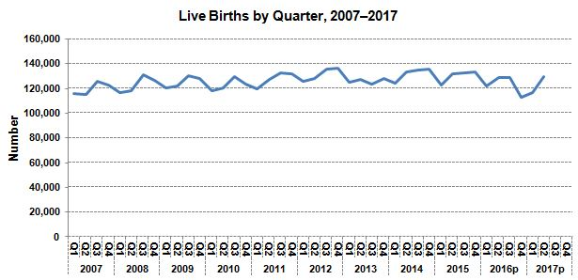
Source: Department of Statistics, Ministry of Economy Malaysia

Slide 40
If birthday distributions are not uniform, the birthday paradox worsens!
# | Probability
23 | 50.7%
30 | 70.6%
40 | 89.1%
50 | 97.0%
55 | 98.6%
60 | 99.5%
70 | 99.9%
# | Probability
23 | > 50.7%
30 | > 70.6%
40 | > 89.1%
50 | > 97.0%
55 | > 98.6%
60 | > 99.5%
70 | > 99.9%

Slide 41
Penny has two children. One of them is a girl. What’s the probability that the other child is a boy?
(Assume boy-girl probability is 50-50. and the
sexes of different children are independent)

Slide 42
1/2 ? 2/3?

Slide 43
Possibilities
BB
BG
GB
GG
2/3

Slide 44
Penny has two children. One of them is a girl. What’s the probability that the other child is a boy?
Penny has two children. The younger is a girl. What’s the probability that the other child is a boy?
Possibilities
BB
BG
GB
GG
2/3
Possibilities
BB
BG
GB
GG
1/2

Slide 45
Applications!

Slide 46
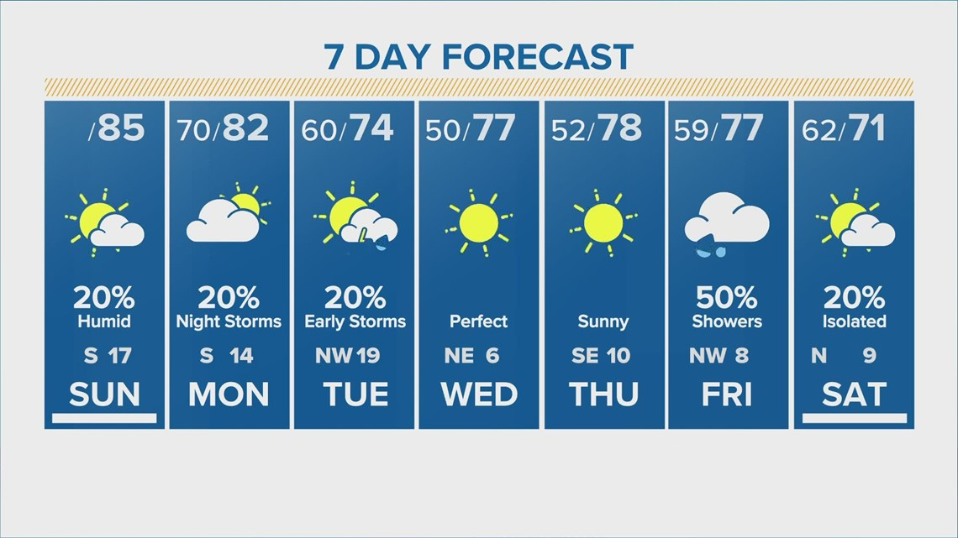
Weather Forecasting

Slide 47
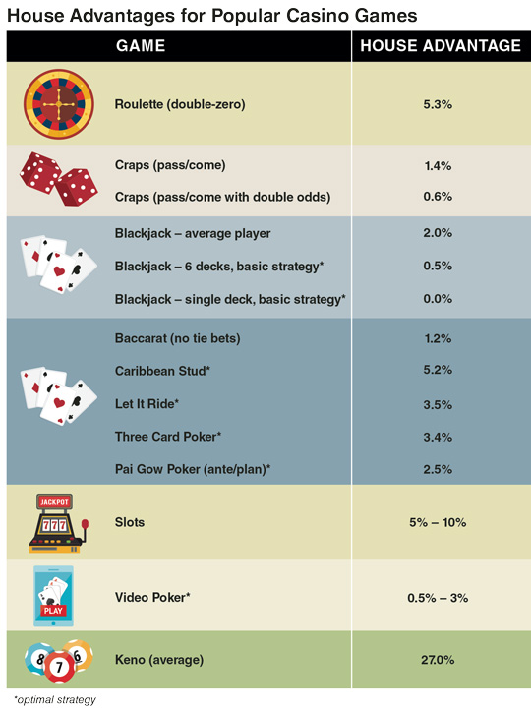
Understanding Gambling

Slide 48
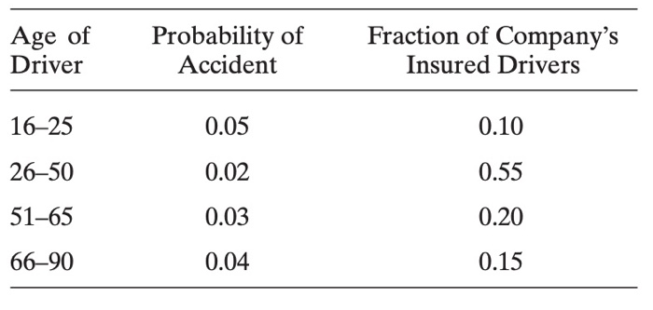
Actuarial Science / Insurance Policies

Slide 49
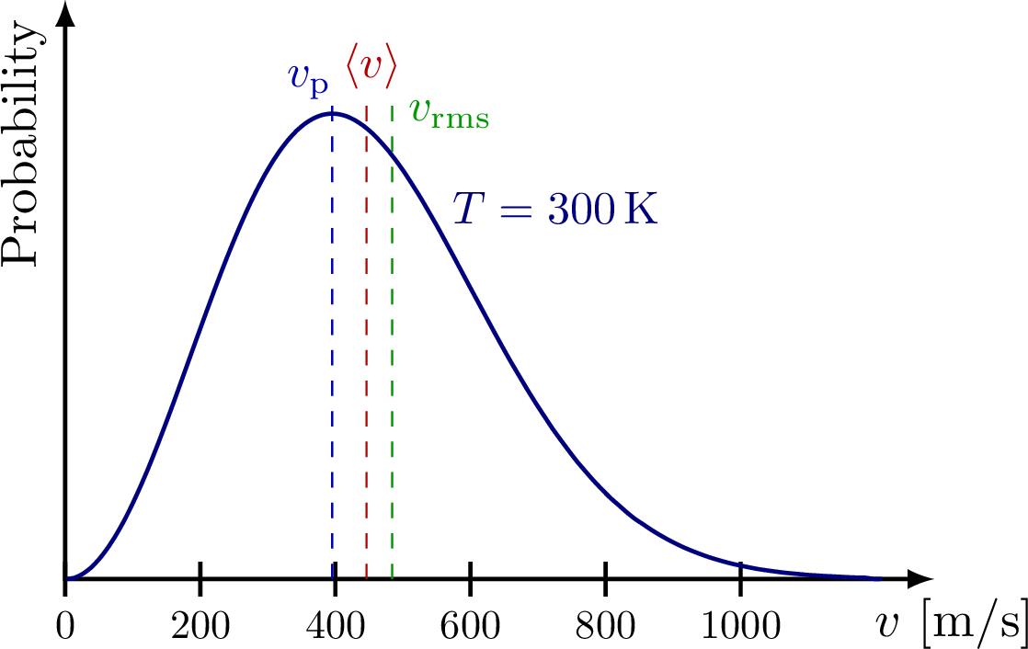
Statistical Mechanics: Particle Behaviour

Slide 50
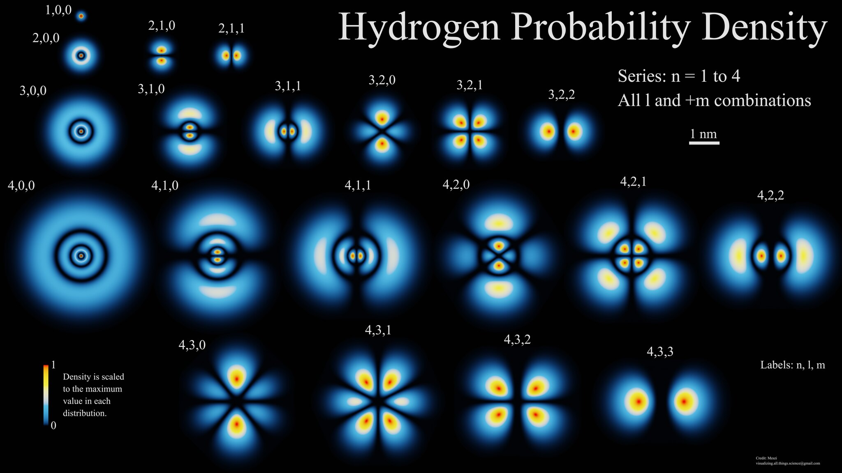
Quantum Mechanics: Electron Orbitals

Slide 51
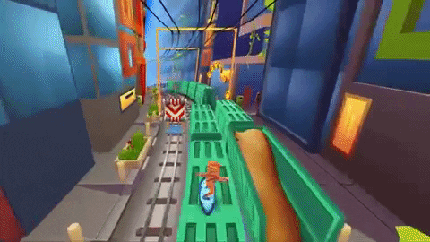
Thank You!

